Slide 1
Private vs Personal information
by

Slide 2

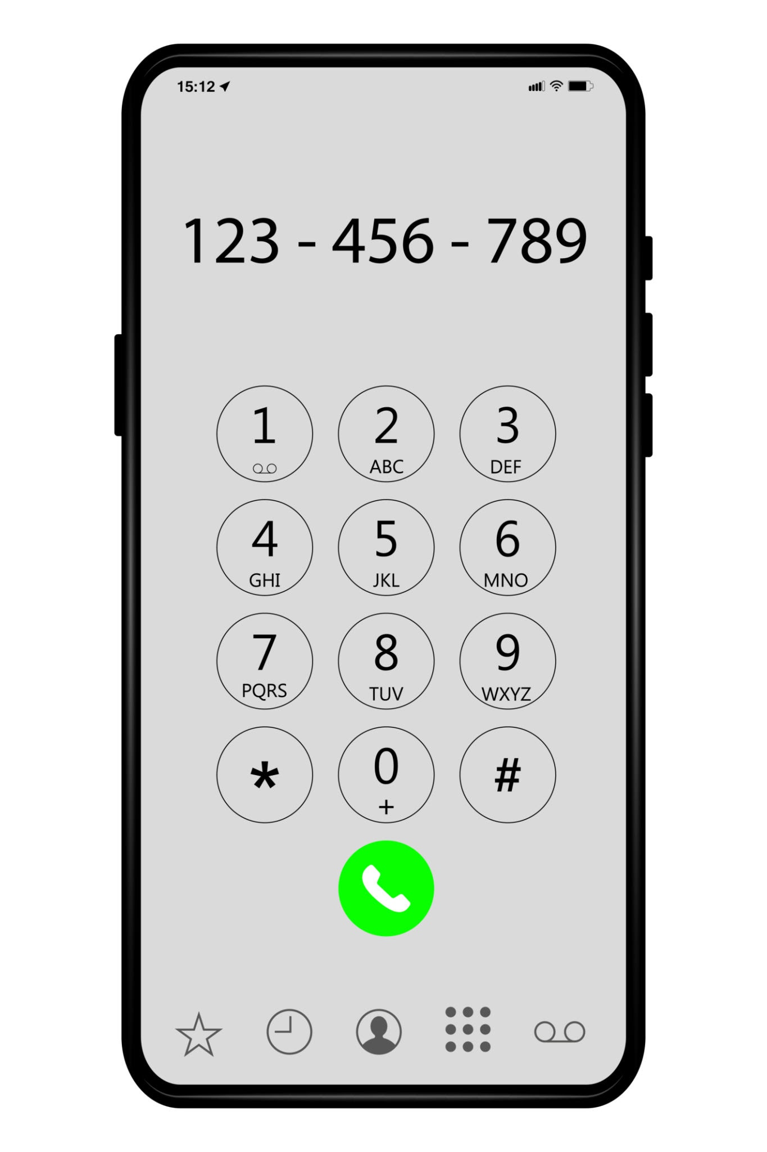
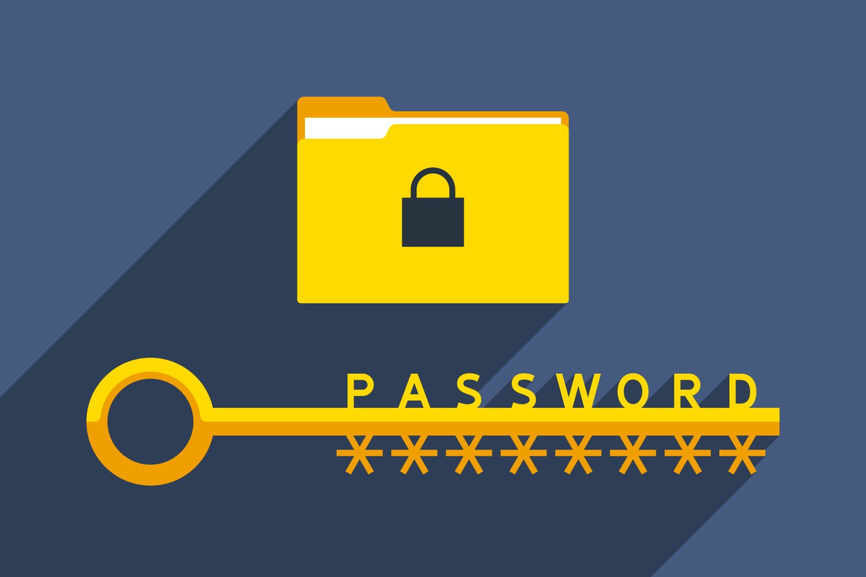


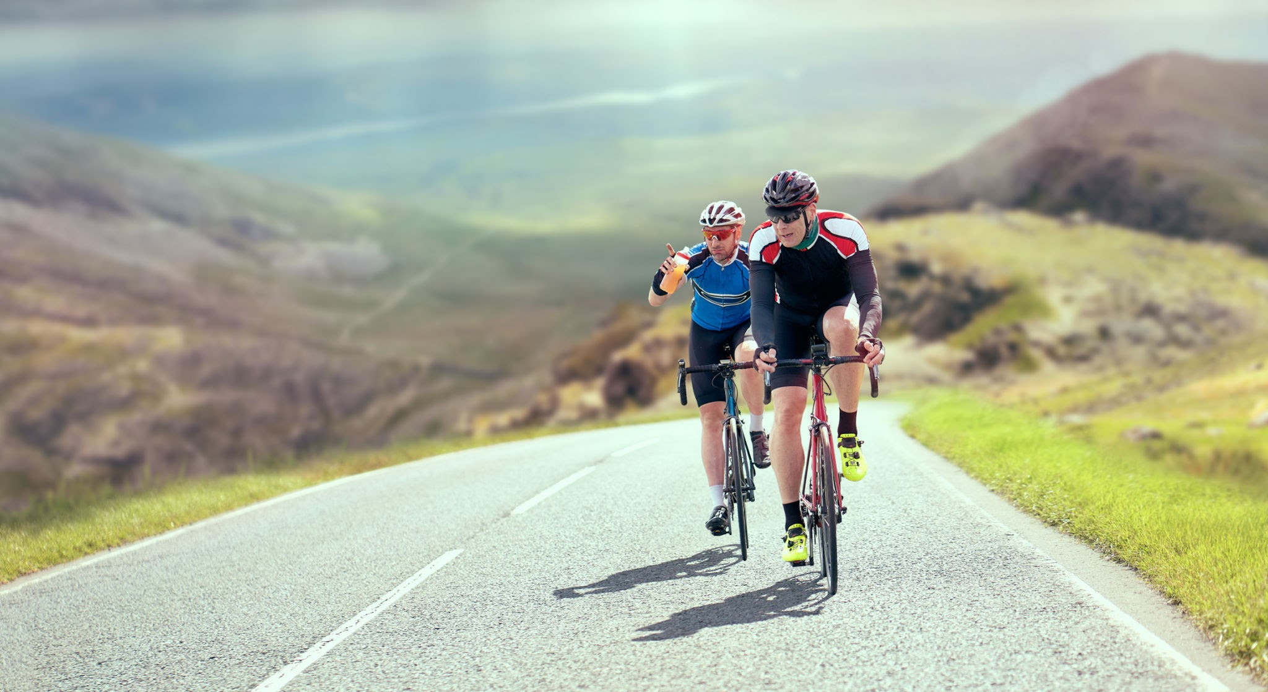
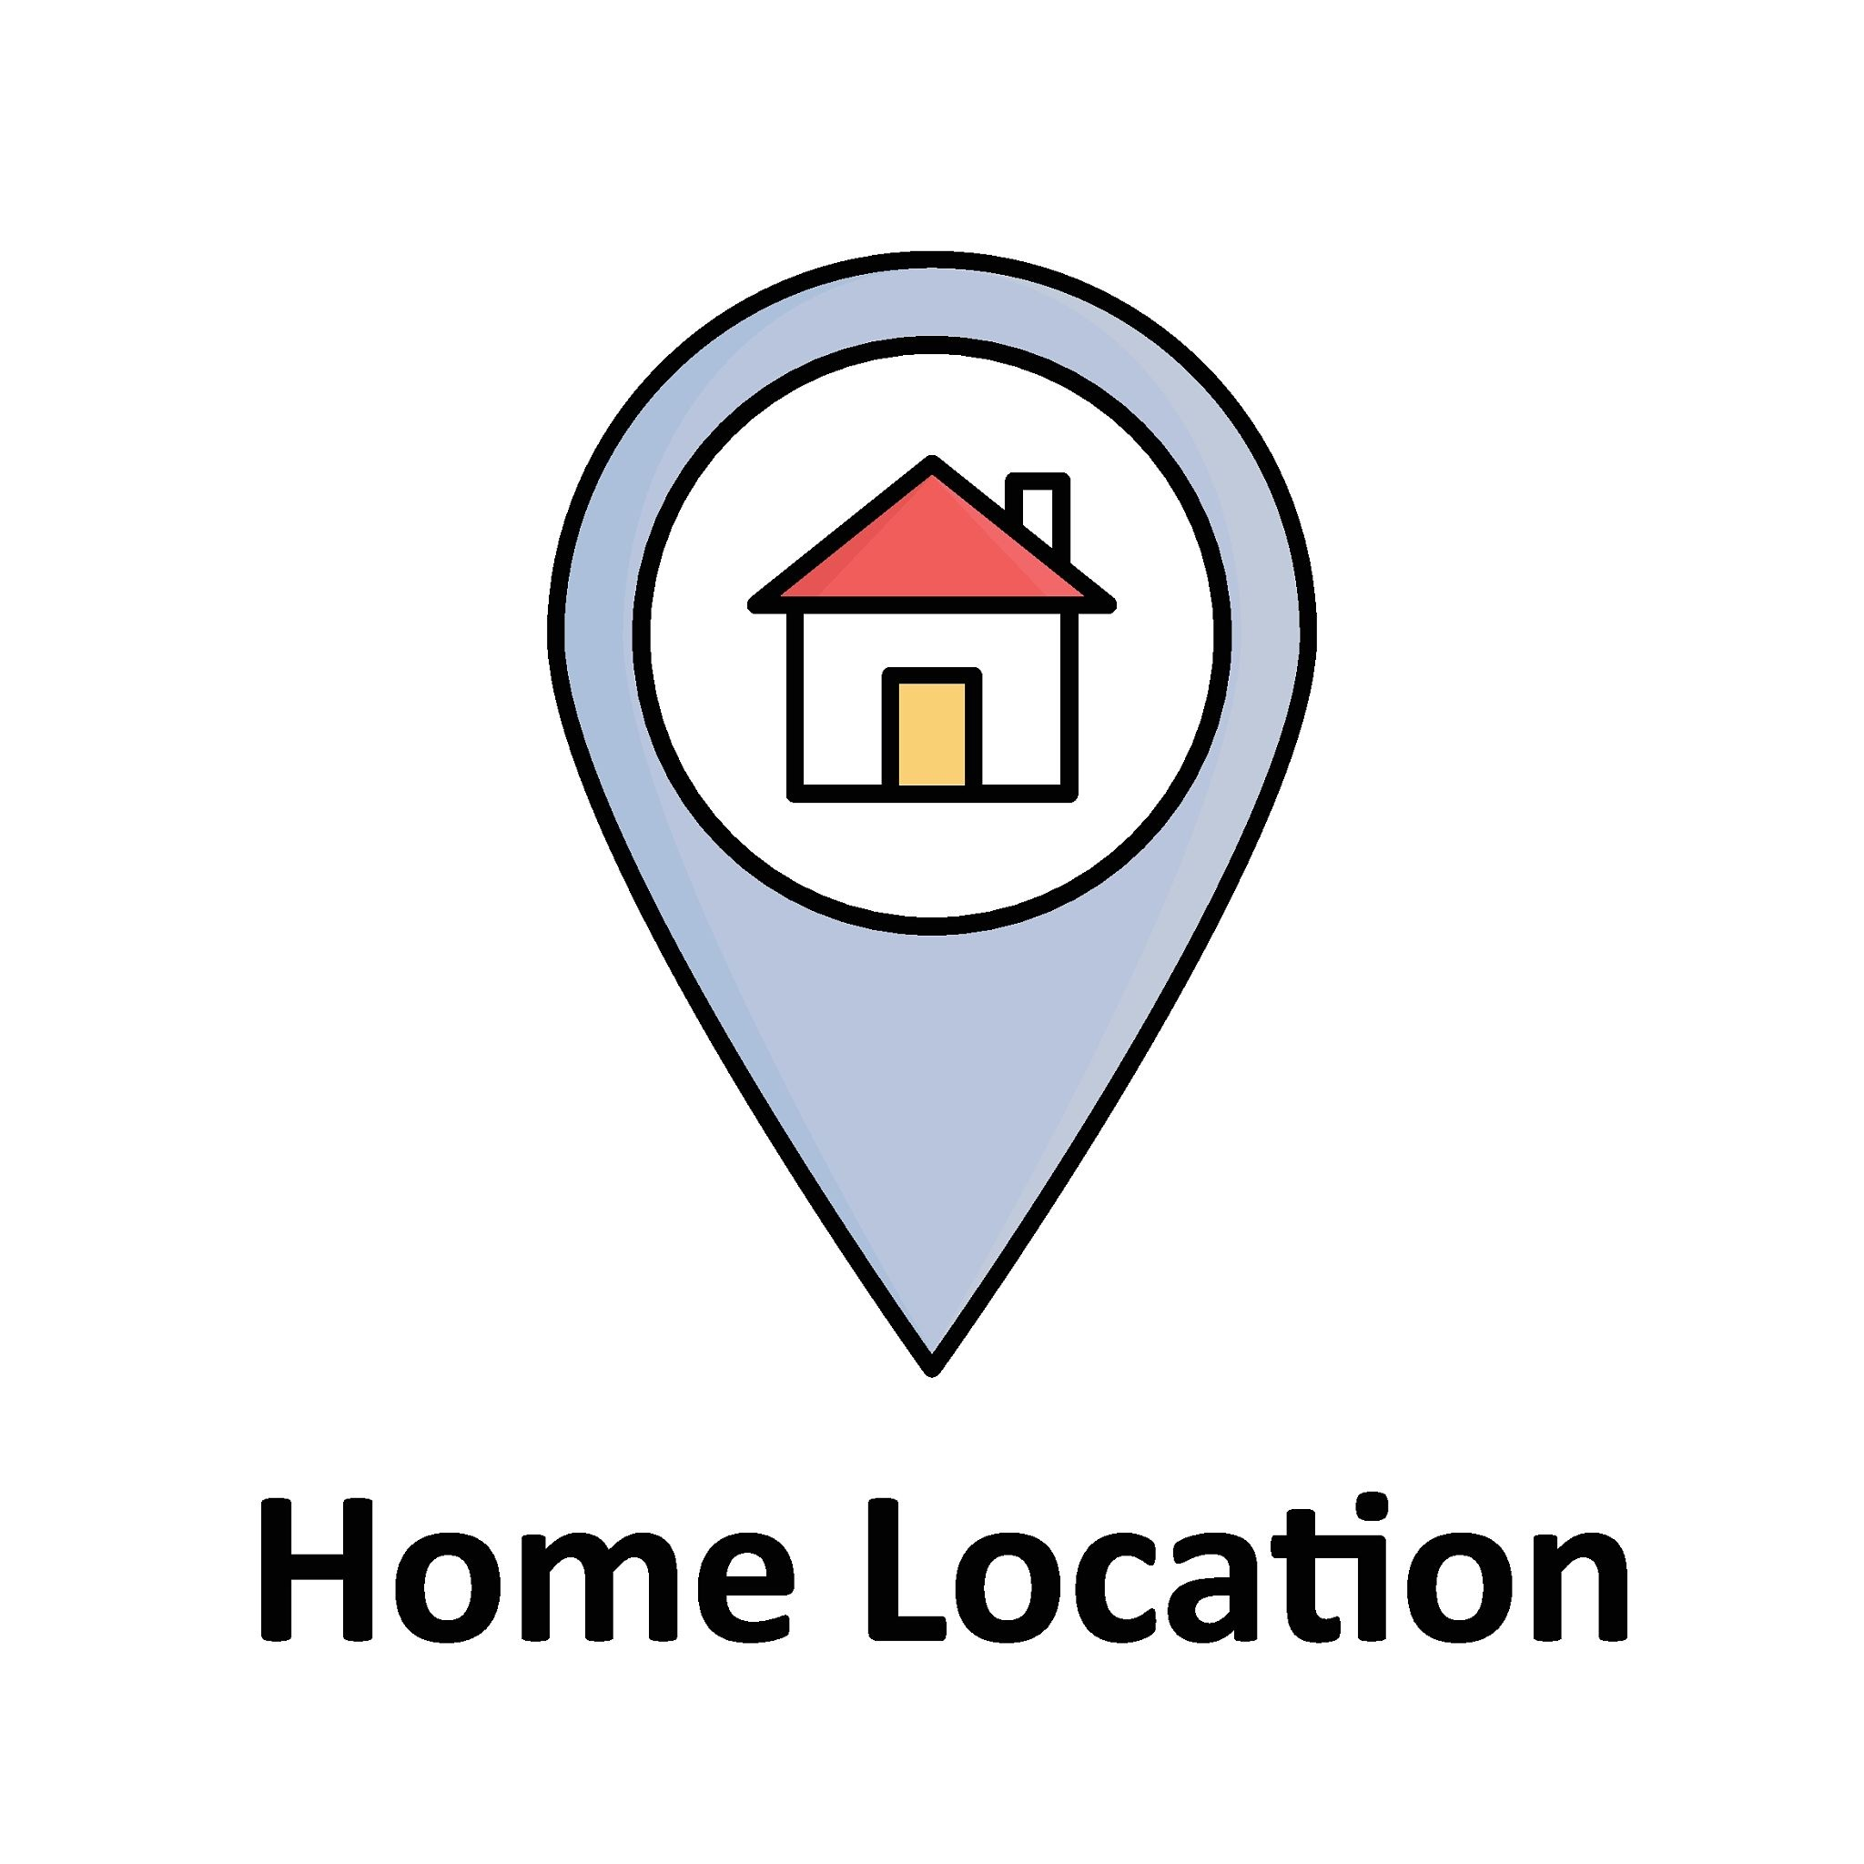

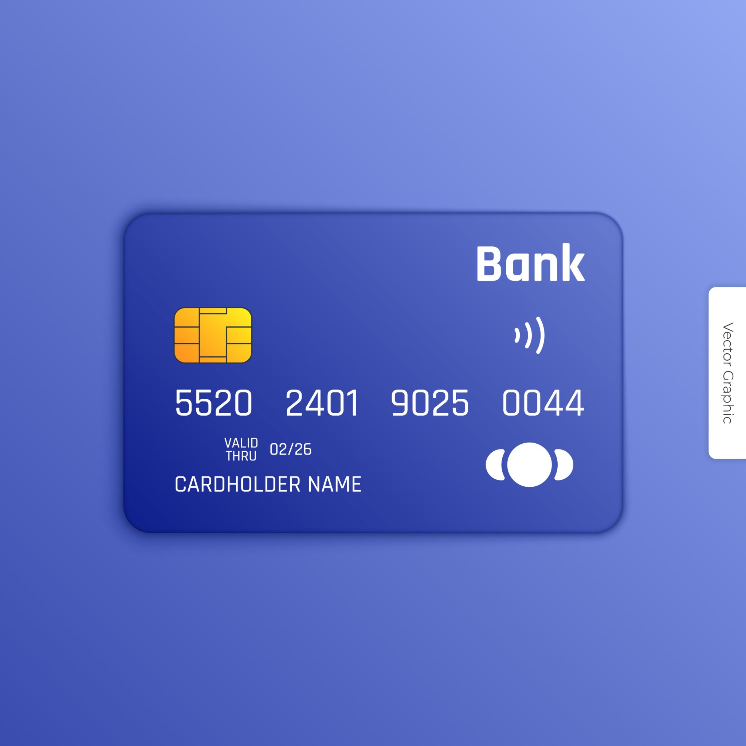


Private
Personal
Add 4 of your own images

Slide 3
What could happen if you share private information online?
If I shared my photo, the strangers might steal it and use it for bad purposes.

Slide 4
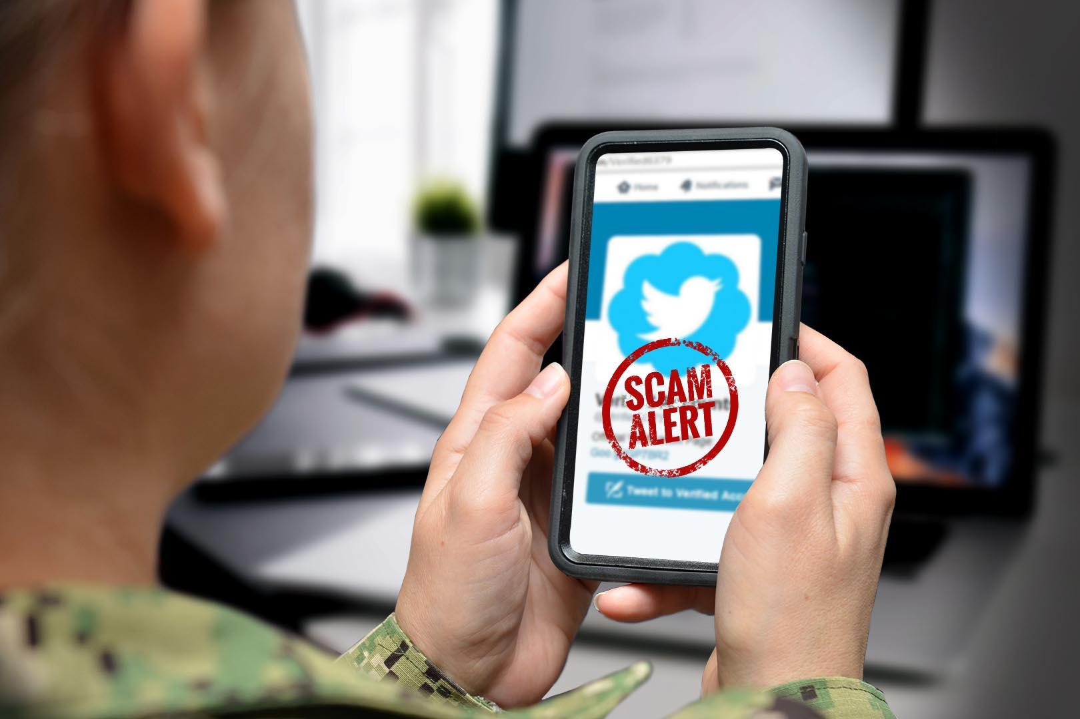
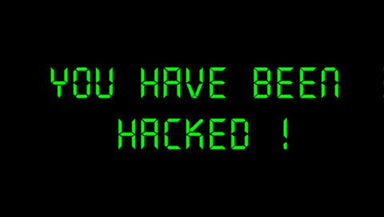

What could happen if you share private information online?
If I share my number online I might get spam phone calls.
If share my location online someone could find me and cause me harm.
If I share my passwords online then someone could pretend to be me.

